Slide 1

A Project on Sentiment Analysis of Student Feedback
Presented by
Hemavati M. Sabu
Roll No. ME17F05F010
Under the guidance of
Dr. V. P. Kshirsagar

Slide 2
Introduction
Why feedback required?
Why textual feedback?
Why automation required?

Slide 3
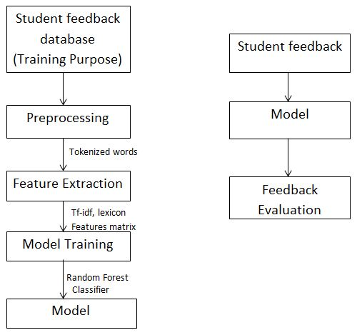
System Block Diagram

Slide 4
Dataset
Dataset Creation-
Using Internet, friends’ comments and my own comments
Total comments 371
Positive comments 294 (labeled by 1)
Negative Comments 67 (labeled by -1)
Neutral Comments 10 (labeled by 0)

Slide 5
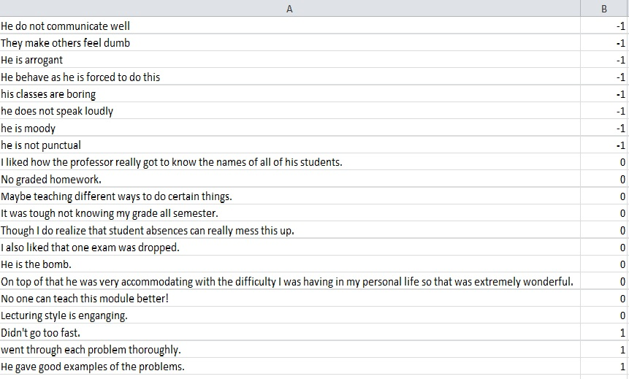

Slide 6
Preprocessing
Punctuations
Tokenization
Case conversion
Stop words

Slide 7
Approaches Used
Lexicon Based Approach
Machine Learning Approach (Random Forest Classifier)

Slide 8
Lexicon Based Approach
Tokenize a sentence
Find sentence sentiment score using negative, positive, invertor dictionaries
For Negative : add -1 to score
For Positive: add 1 to score
For Negation: multiply score by -1
For incrementing word: double the score
For decrementing words: half the score

Slide 9
Example:
He is very good teacher.
After preprocessing: [very, good, teacher]
Positive word: {good}
Negative word: {}
Incrementing words:{very}
Decrementing words:{}
Negation:{}
Hence, Total Sentiment score = (1+0)*2
= 2
Sentiment Score>0 : Positive Polarity
Sentiment Score<0 : Negative Polarity
Senitiment Score=0 : Neutral Polarity

Slide 10
Feature Extraction
Lexicon
Using the polarity of each word in a sentence
TF-IDF features
It is a way to score the importance of words (or "terms") in a document based on how frequently they appear across multiple documents.
term frequency (tf) = count(word, document) / len(document)
inverse document frequency (idf) = log( len(collection) / count(document_containing_term, collection) )
idf(d, t) = log [ (1 + n) / (1 + df(d, t)) ] + 1
tf-idf(d, t) = tf(t) * idf(d, t)

Slide 11
Random Forest Algorithm
Create multiple decision trees
Takes the test features and use the rules of each randomly created decision tree to predict the outcome and stores the predicted outcome (target)
Calculate the votes for each predicted target.
Consider the high voted predicted target as the final prediction from the random forest algorithm.

Slide 12
Machine Learning Approach
Random Forest Algorithm used
Predicted Variables:
Tfidfpos, Tfidfneg, Tfidfneu, Lexicon

Slide 13
Performance Analysis
Accuracy=Total Correct Predicted Output
Total No. of Comments
Lexicon Based Approach:
Accuracy ~ 70%
Machine Learning Approach
Accuracy ~ 71%

Slide 14
Performance Analysis
Polarity | Total Comments | Correct Prediction | Wrong Prediction | Accuracy (Percentage)
Positive | 294 | 230 | 64 | 78.23
Negative | 67 | 28 | 29 | 41.79
Neutral | 10 | 3 | 7 | 30
Total | 371 | 261 | 110 | 70.35
Lexicon Based Approach Performance Analysis

Slide 15
Performance Analysis
Polarity | Total Comments | Correct Prediction | Wrong Prediction | Accuracy (Percentage)
Positive | 294 | 235 | 59 | 79.93
Negative | 67 | 30 | 37 | 44.77
Neutral | 10 | 0 | 10 | 0
Total | 371 | 265 | 106 | 71.42
Machine Learning Approach Performance Analysis

Slide 16
Conclusion
The presented approach employed machine learning methods along with sentiment lexicons. In contrast to lexicon-based approach, the proposed approach of combining the use of sentiment lexicon with machine learning techniques was capable of predicting the sentiment of the textual content even if the opinion words do not exist in the lexicon. However, the presented approach is limited to the computation of overall sentiment of the student feedback.

Slide 17
Future Work
The future work would include fine-grained analysis of student feedbacks at the aspect level. Other machine learning approach such as SVM, Naive Baye’s classifier may help in improving the quality of analysis giving nearby 100% accuracy. Further, increasing available comments dataset and making the distribution of negative and positive comments uniform in the dataset may help in improving accuracy.

Slide 18
References
[1] Zarmeen Nasim, Quratulain Rajput and Sajjad Haider, “Sentiment Analysis of Student Feedback Using Machine Learning and Lexicon Based Approaches”, Research and Innovation in Information Systems (ICRIIS), IEEE, 2017
[2] Ankur Joshi, Saket Kale, Satish Chandel and D. K. Pal, “Likert Scale: Explored and Explained”, British Journal of Applied Science Technology, Article no.BJAST.2015.157, 2015
[3]Quratulain Rajput, Sajjad Haider, and Sayeed Ghani , “Lexicon-Based Sentiment Analysis of Teachers’ Evaluation”, Hindawi Publishing Corporation Applied Computational Intelligence and Soft Computing, Volume 2016, Article ID 2385429, 2016.
[4] Justin C. W. Debuse and Meredith Lawley, “Computer based assessment and feedback”, 2014.
[5] P. D. Turney, “Thumbs up or thumbs down?: semantic orientation applied to unsupervised classification of reviews”, in Proceedings of the 40th annual meeting on association for computational linguistics Association for Computational Linguistics, 2002, pp. 417424.

Slide 19
THANK YOU!

